Slide 1
Telco Customer Churn
Aditya Bahl

Slide 2
Contents
Objective
1
Data Exploration
2
Segmentation
3
Insights & Recommendations
4
Results
5

Slide 3
Objective
To predict
Customers who churn*
Cause of Churn
Make recommendations to handle churn
*Customers who churn - customers who cut ties with your service or company

Slide 4
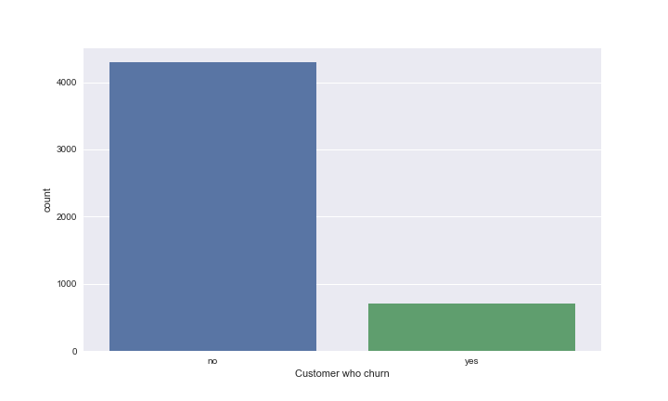
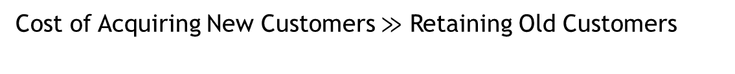
Data Exploration
Cost of Acquiring New Customers $≫$ Retaining Old Customers
Total Customers= 5000
Customers who churned= 707
Imbalanced Dataset

Slide 5
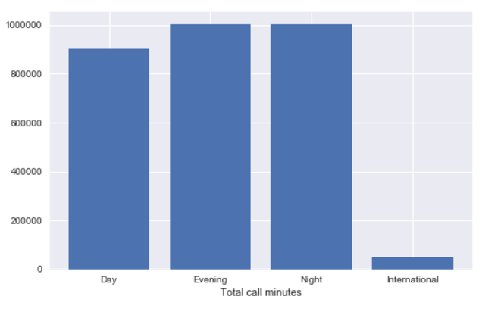
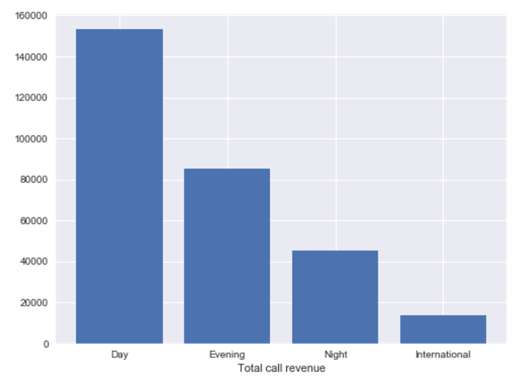
Customer Usage details
Day calls have the largest revenue share

Slide 6
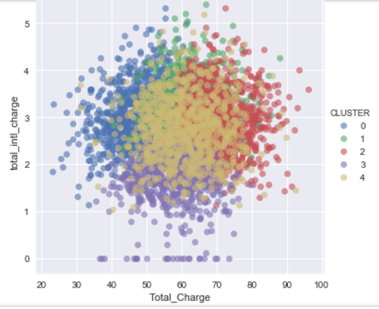
Customer Segmentation
Algorithm Used: K Means Clustering
5 Customer clusters based on usage
Further analysis for each cluster
Decision Tree Model - Why customer churns ?
Random Forest Model – Which customer churns ?

Slide 7
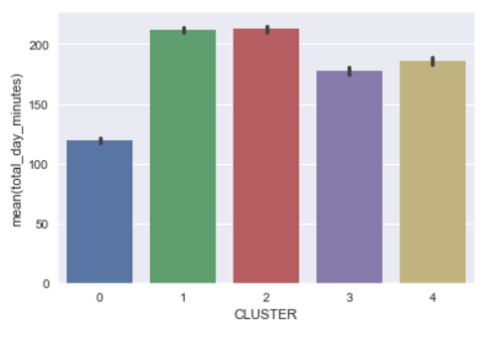
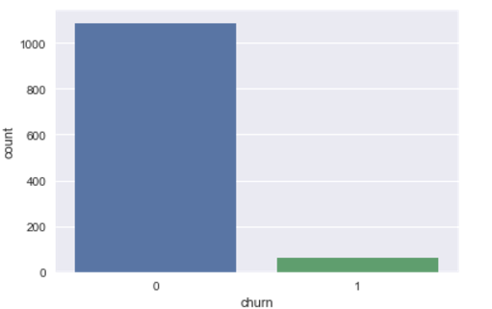
Cluster 0 – Low Day Users
Customer Churn category | Recommendation
With international plan and total international minutes > 13.0 | Offer free international minutes
With international plan ,having total international minutes < 13.0 and total international calls < 3 | Offer 4 free international calls to customers with low international usage.

Slide 8
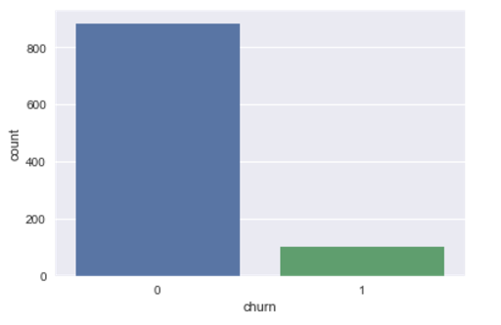
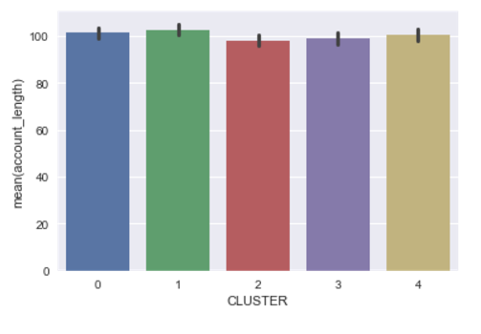
Cluster 1 – Oldest Customers
Customer Churn category | Recommendation
With no international plan ,Total_Charge > $73.97 and day rate > $0.17 | Offer day calling discounts to customers with Total charge > $73.97
With international plan , with Total_Charge <$73.97 & total_intl_charge > $3.535 | Offer discounted international calling to Customers with total charge < $73.97

Slide 9
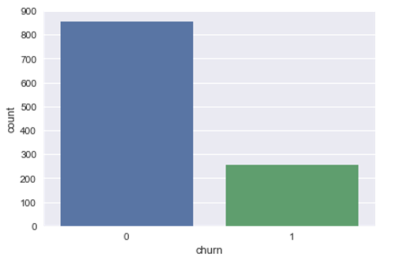
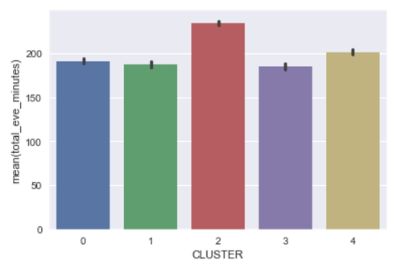
Cluster 2– Evening Users
Customer Churn category | Recommendations
With Total charge greater than $74.23 and with no Voicemail plan | Offer discounted/free Voicemail plans for customers with Total Charge > $74.23
With Total charge less than $74.23 , having international plan but having total international minutes > 13.0 | Offer free long duration international calls for customers with Total Charge < $74.23

Slide 10
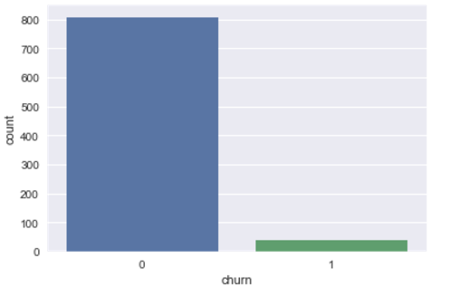
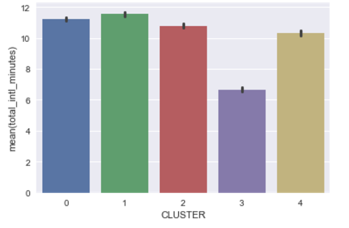
Cluster 3 – Least Churn/Low International Callers
Customer Churn category | Recommendations
With Total Charge > $74.13, total night charge < $10.76 | Offer discounted day & eve call rates to customers with Total charge > $74.13
With Total Charge < $74.13 , having international plan but having total international calls < 3 | Offer 4 free international calls to customers with Total charge < $74.13

Slide 11
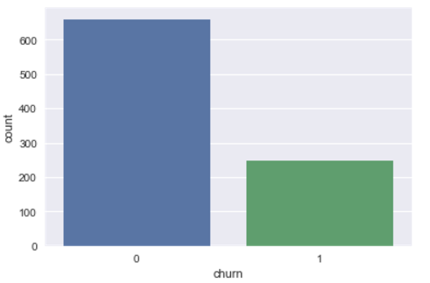
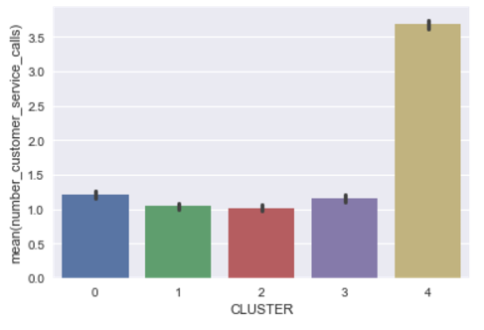
Cluster 4 – Most Churn/Customer Service Problems
Customer Churn category | Recommendations
Number customer service calls > 4 and Total Charge <= $56.73 | Prioritized customer service to customers with Total_Charge < $56.73 based on customer value.
Number customer service calls < 4 , Total Charge > $73.92 and total day minutes <= 271.85 | Offer free day minutes to customers with Total Charge > $73.92 & total day minutes <= 271.85

Slide 12
Results
Potential annual revenue loss of approx. $555,700 averted
Predicted which customer churns and why
Provided targeted recommendations based on Machine Learning models for each customer segment

